Slide 2
Table of Contents
Introduction
Problem Statement
Requirements
Use Case Diagram
Case Description
Activity Diagram
Sequence Diagram
Class Diagram
ER Diagram
Conclusion
References

Slide 3
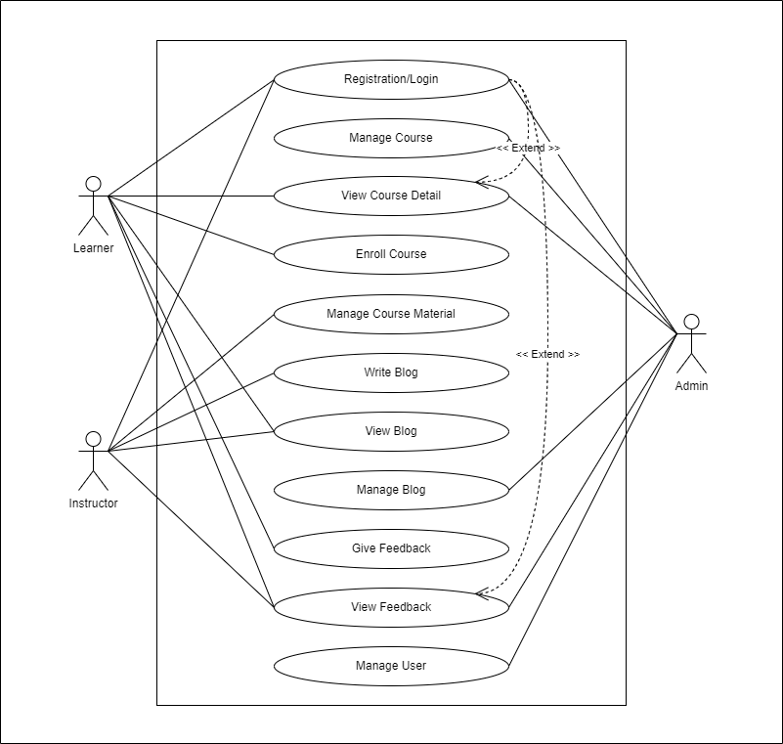
Use Case Diagram

Slide 4
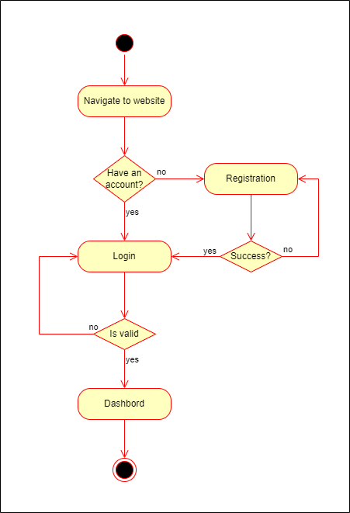
Activity Diagram (Registration/Login)

Slide 5
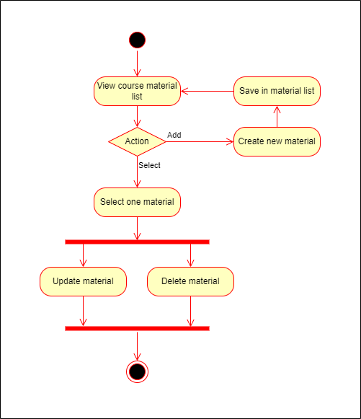
Activity Diagram (Manage Course)

Slide 6
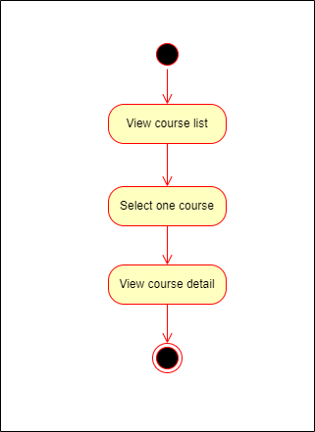
Activity Diagram (View Course Detail)

Slide 7
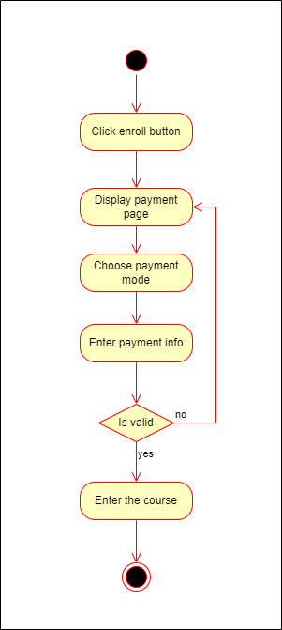
Activity Diagram (Enroll Course)

Slide 8
Activity Diagram (Enroll Course)

Slide 9
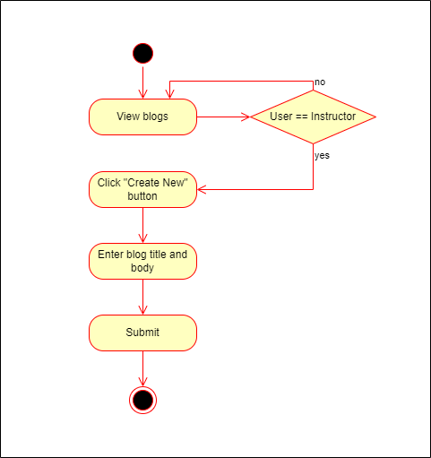
Activity Diagram (Write Blog)

Slide 10
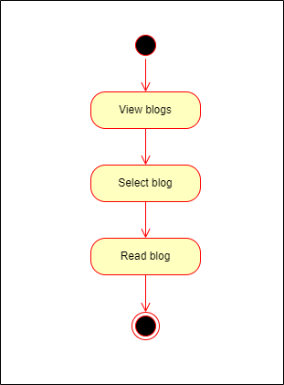
Activity Diagram (View Blog)

Slide 11
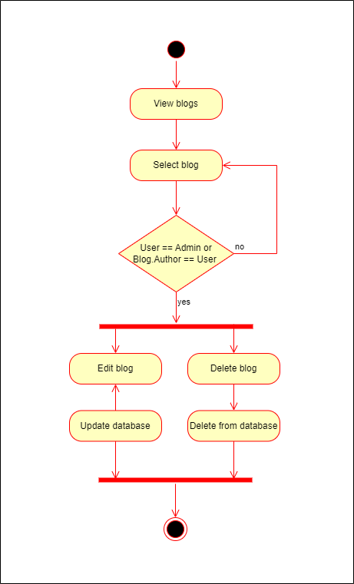
Activity Diagram (Manage Blog)

Slide 12
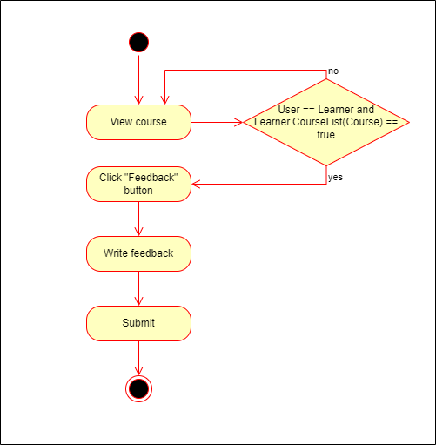
Activity Diagram (Give Feedback)

Slide 13
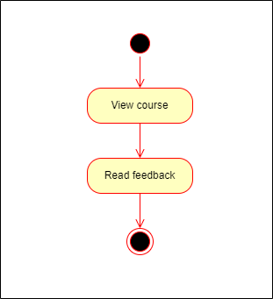
Activity Diagram (View Feedback)

Slide 14
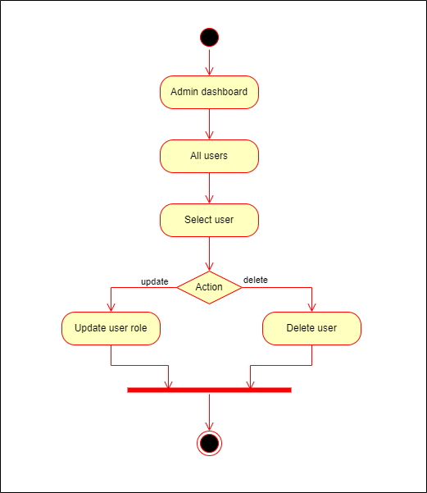
Activity Diagram (Manage Users)

Slide 15
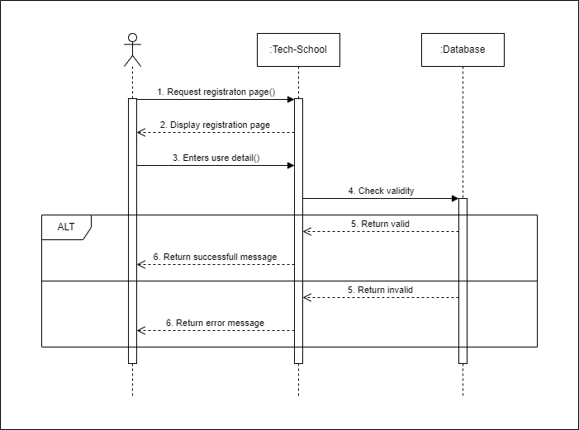
Sequence Diagram (Registration/Login)

Slide 16
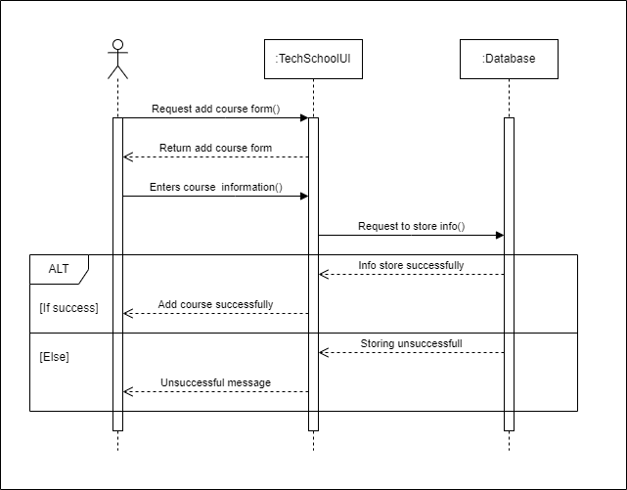
Sequence Diagram (Add Course)

Slide 17
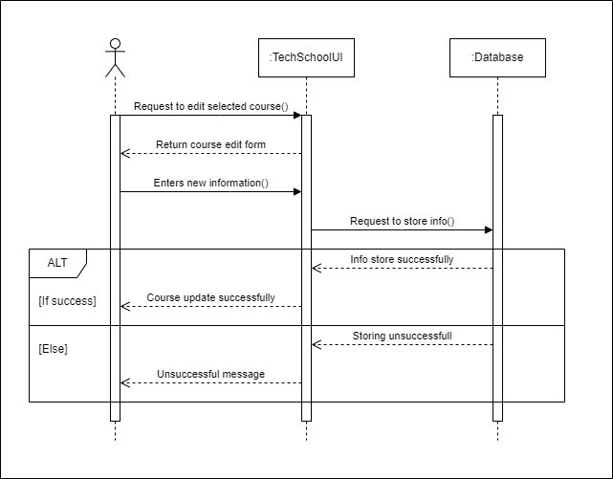
Sequence Diagram (Edit Course)

Slide 18
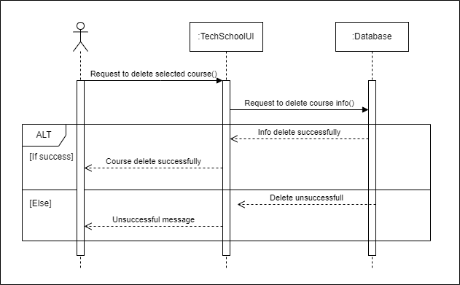
Sequence Diagram (Delete Course)

Slide 19
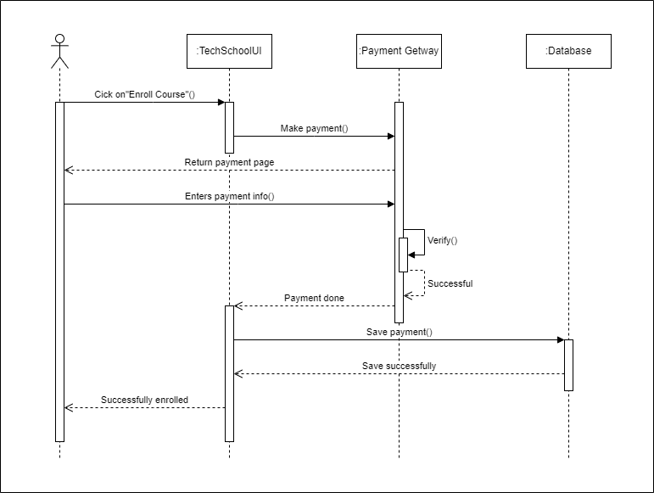
Sequence Diagram (Enroll Course)

Slide 20

Sequence Diagram (Add Course Material)

Slide 21

Sequence Diagram (Edit Course Material)

Slide 22

Sequence Diagram (Delete Course Material)

Slide 23
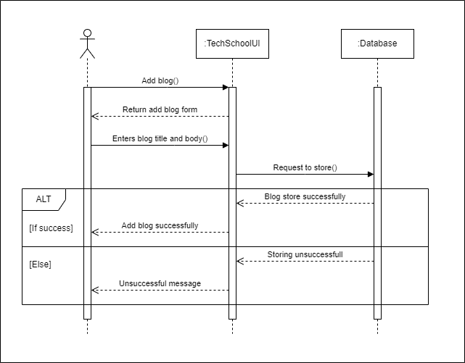
Sequence Diagram (Add Blog)

Slide 24

Sequence Diagram (Edit Blog)

Slide 25
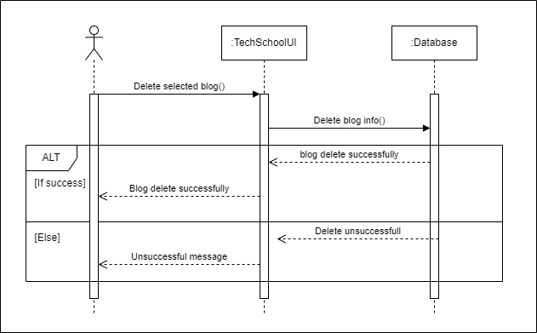
Sequence Diagram (Delete Blog)

Slide 26
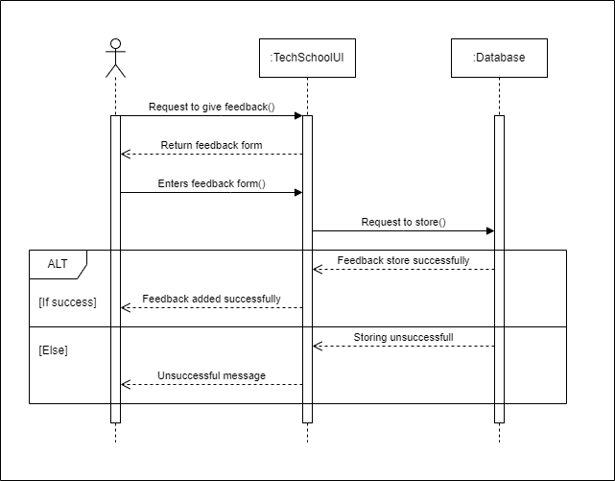
Sequence Diagram (Add Feedback)

Slide 27

Sequence Diagram (User Removal)

Slide 28
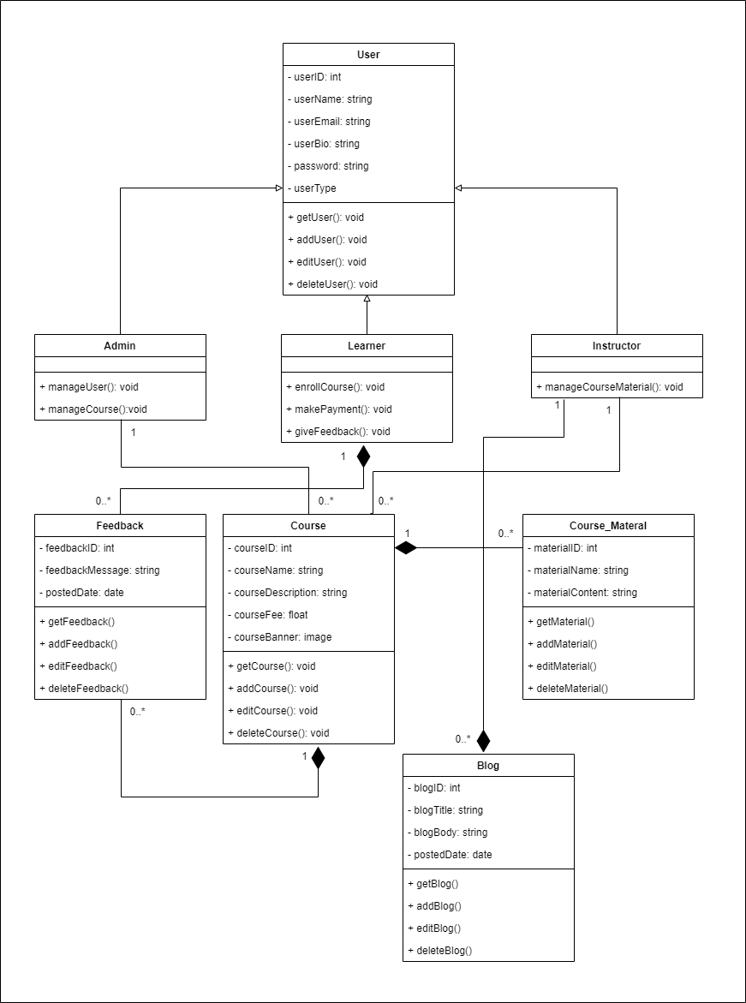
Class Diagram

Slide 29
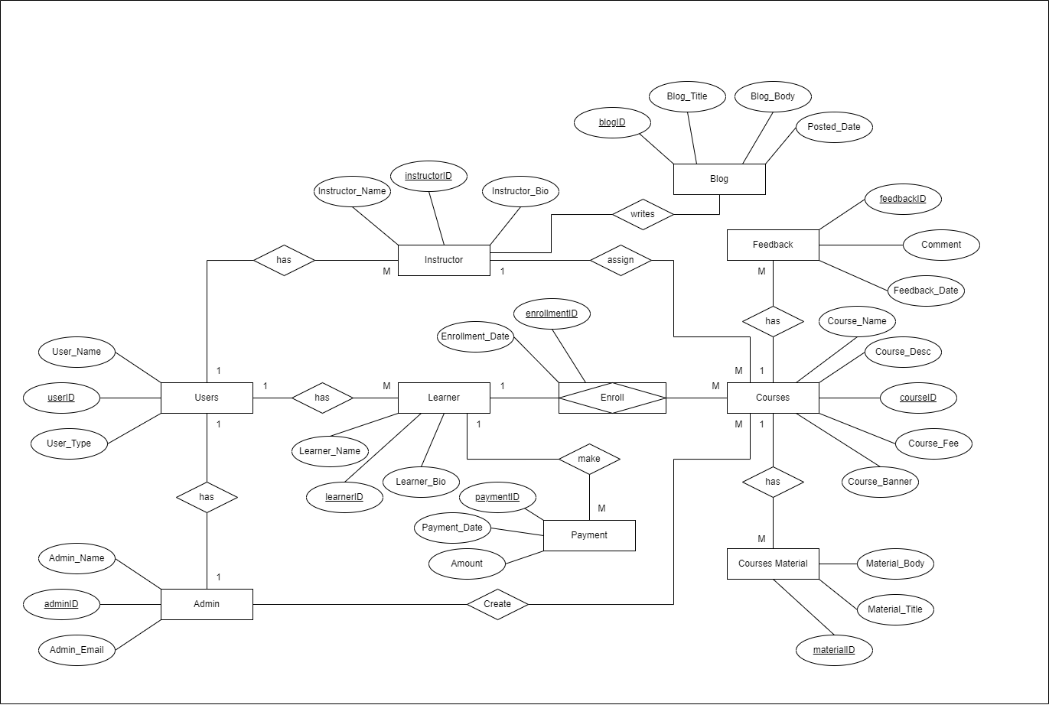
ER Diagram

